Slide 1

Cyber Security
Lecture # 04

Slide 2
Lecture Overview
Network Basics
Hub
Switch
Router
Data Transmission
TCP/IP Protocols
Ports

Slide 3
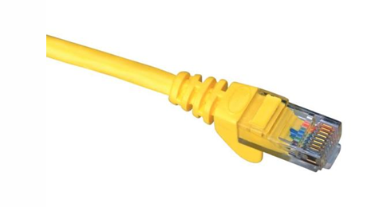
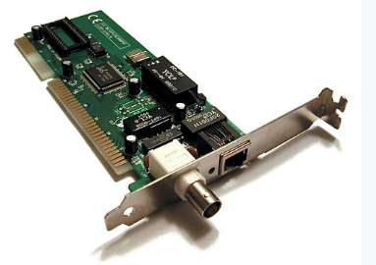
Network basics
A network is two or more connected computers.
A connection usually requires Network Interface Card (NIC) in both wire (cable) or wireless connection.
Traditional NIC uses a RJ 45 connector.
Uses a RJ 45 connector.
Allows the host to connect to the network.

Slide 4
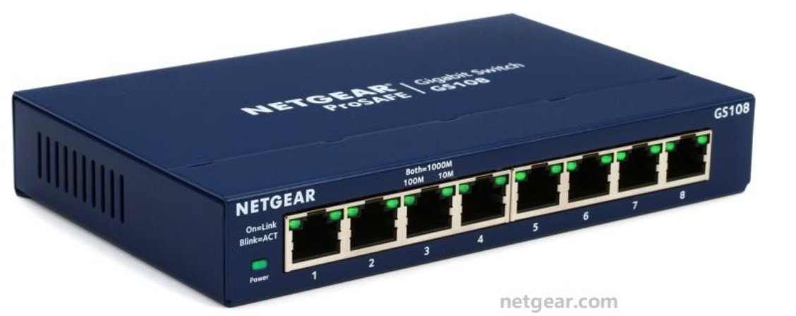
Network basics
The HUB is the simplest connection device, creates a simple network.
It will have 4 or more (commonly up to 24) RJ-45 jacks called ports.
A hub can connect as many computers as it has ports.
Sends traffic out all ports (no routing or switching) and has a layer 1 device.
Quick Question?
If I need to connect more than 100 computers, how can I do that?
Using devices like a Hub, Switch, or Router with RJ45 cables!

Slide 5
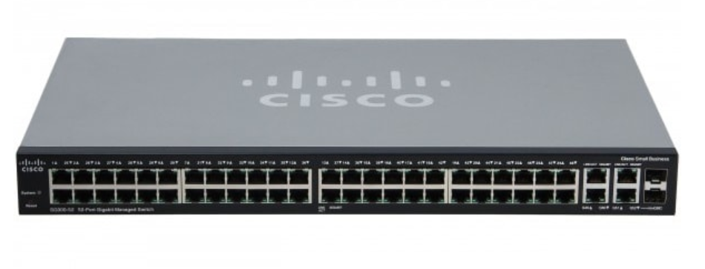
Network basics
The SWITCH is a smarter version of hub.
Sends packets only to the intended host.
It rely on MAC (Media Access Control) address, found in the ethernet header of the packet.
A layer 2 device

Slide 6
Network basics
Every device connected to the switch has a unique MAC address.
The switch keeps a MAC address table (like a contact list), it learns which MAC address belongs to which port.
How It Works:
When a packet arrives, the switch checks the destination MAC address in the Ethernet header.
Then it forwards that packet only to the port linked to that MAC address.

Slide 7
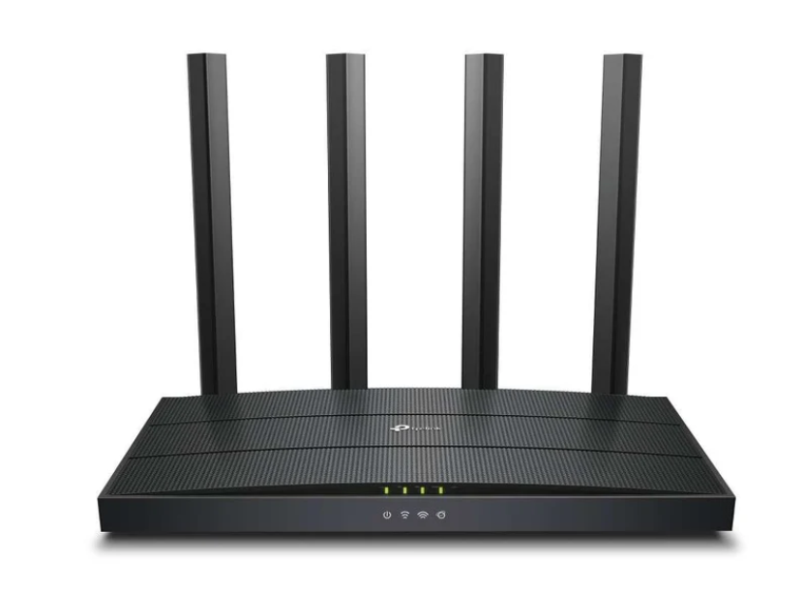
Network basics
The ROUTER is more sophisticated.
It connects different networks (like your home network to the internet).
It decides where to send data using IP addresses.
A layer 3 device
Quick Question?
Difference btw Hub, Switch and Router?

Slide 8
Data transmission
How is data actually transmitted?
To transmit data , a packet is sent.
The basic purpose is to transmit data from one machine to another.
It does not matter, the packet is a document, image, audio, video or any signal from the computer.
It always stored as 1s and 0s, called bits.
Packet is divided into header and body.

Slide 9
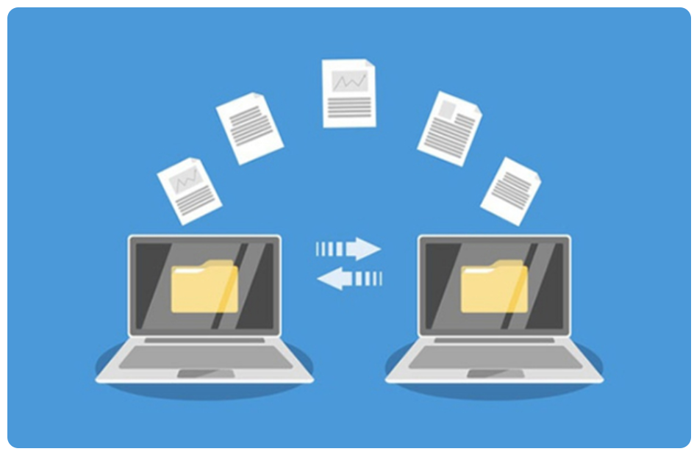
Packet headers tell where the packet is going.
Network devices (Switches/Routers) read the headers to determine where the packet should be sent.

Slide 10
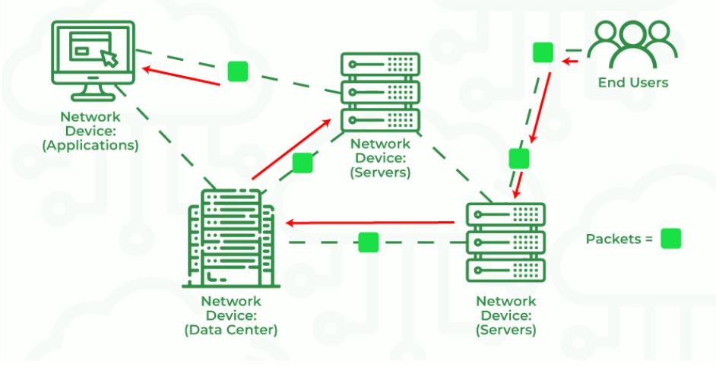

Slide 11
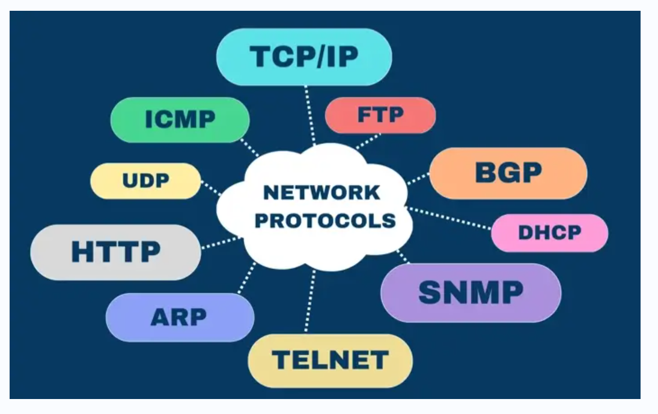
PROTOCOLS
Different types of network communications for different purposes are called Protocols.
Rules that control network and Internet communication.
Each Protocol has specific purpose and normally operates on certain Port.
Internet Engineering Task Force
(IETF) controls these rules.
Quick Read!
Transmission Control Protocol (TCP) is connection-oriented.
Internet Protocol (IP) is connectionless.

Slide 12
TCP/IP PROTOCOLS
The TCP/IP protocols are the foundation of how data is transferred and communicated over the internet.
FTP (File Transfer Protocol) is used to transfer files between computers.
FTPS (File Transfer Protocol Secure) is a more secure version that uses encryption to protect data.
SMTP (Simple Mail Transfer Protocol) handles the sending of emails.
IMAP (Internet Message Access Protocol) is used to receive and manage emails on a mail server

Slide 13
DNS (Domain Name System) translates domain names like google.com into IP addresses that computers understand.
HTTP (Hypertext Transfer Protocol) is used to transfer web pages, and its secure version.
HTTPS (Hypertext Transfer Protocol Secure), encrypts data for safe browsing.
TCP (Transmission Control Protocol) ensures reliable and ordered data delivery
UDP (User Datagram Protocol) focuses on speed and efficiency without guaranteeing delivery. Together, these protocols make network communication and internet usage possible.

Slide 14
PORTS
A connection point.
It is a numeric designation for a particular path of communications.
65535 network communications ports on computer regardless of type of computer and OS.
Not physical ports on a computer.
IP Address + Port number is referred to as a Socket.
Used by protocols to communicate

Slide 15
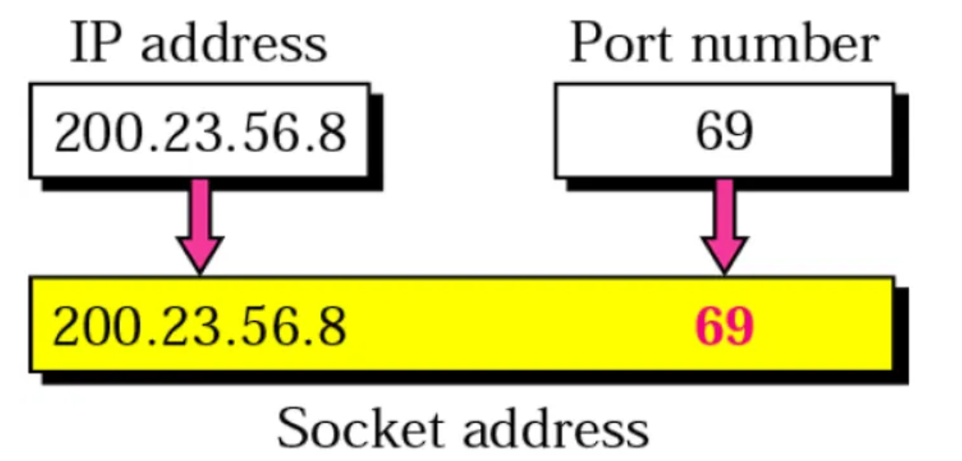

Slide 16
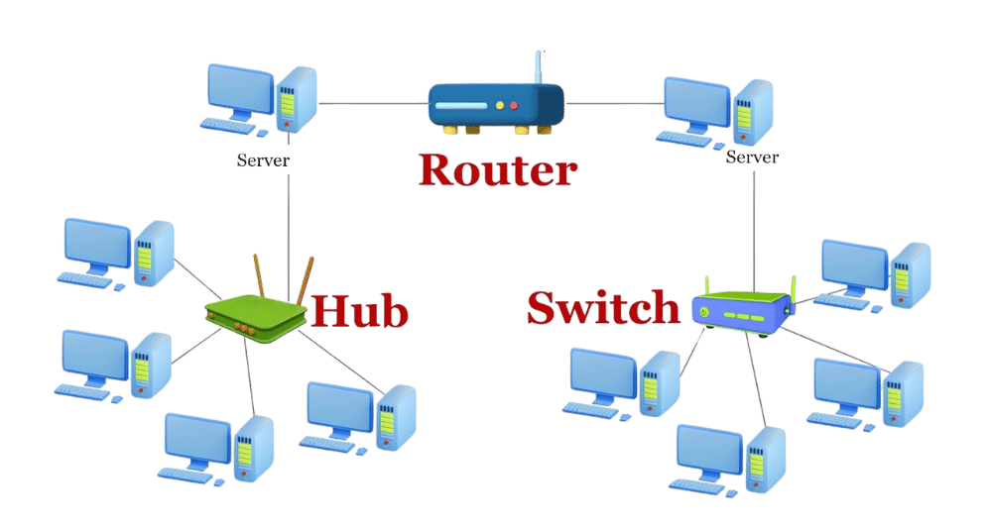
Simply, One machine connected to each other via cables, and perhaps to hubs, switches, or routers. These networks transmit binary information in packets using certain protocols and ports.

Slide 17
Thank you!
“Knowledge is the best program ever written”

